Slide 1

High-dimensional Dataset Publishing Method Satisfying Personalized Differential Privacy Based on Bayesian Network —— 2024 Defense of Dissertation
2020101919 MAM Churou Deng

Slide 2
Content
1. Introduction of Problem
4. HPPrivBayes
2. PrivBayes
5. Experiments
3. Improvements on PrivBayes
6. Conclusion

Slide 3
01
Introduction of Problem

Slide 4
What is our purpose of study?
Why do we want the publication meet differential privacy?
What is differential privacy?
In this paper, we study how to publish a high-dimensional dataset and ensure that the publication will not leak personal privacy information. We will achieve this by using publication algorithm that meets ε-differential privacy protection requirements.
Publishing unprocessed datasets may lead to serious information disclosure risks to the public and illegal risks for data publishers. We want to reduce the risks of information disclosure and protect privacy information during the information transmission.
Differential privacy is a method that has been widely used in privacy-preserving data publishing since it was first proposed in 2006. Differential privacy meets privacy protection requirements by adding an appropriate amount of noise to ensure that modifying one individual record in the data set does not significantly affect the statistical results. This concept can quantitatively analyze privacy and protect the usability of data while reducing the risk of data leakage.

Slide 5
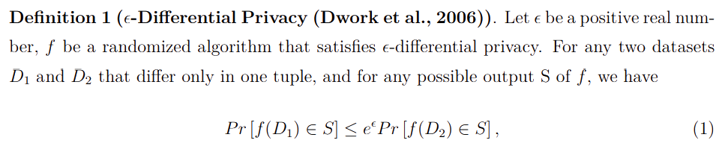
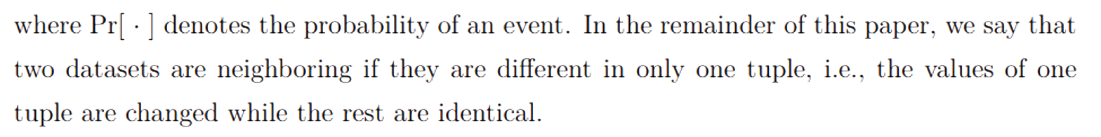
Differential Privacy (see page 5)
Differential privacy can be realized by two typical mechanisms, the Laplace mechanism and the exponential mechanism. Please see Definitions on page 5-6 for details.

Slide 6
02
PrivBayes

Slide 7
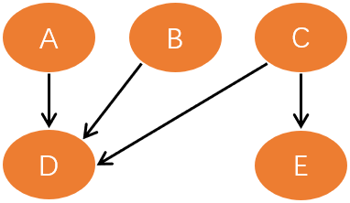
What is PrivBayes? (see page 8-9 for details)
PrivBayes is a high-dimensional dataset publishing method proposed by Zhang et al in 2017, which satisfies ε-differential privacy. This method uses the constructed Bayesian network to reduce the dimension of high-dimensional dataset and then the exponential and Laplacian mechanisms to add noise to the constructed Bayesian network to achieve differential privacy protection.
What is Bayesian network?
A Bayesian network is a directed acyclic graph, which is composed of nodes and edges connecting nodes. For a Bayesian network on a dataset, nodes represent attributes and edges represent conditional independence among attributes.

Slide 8
Problems with PrivBayes?
The selection of the first node in PrivBayes is random, and the mutual information between other nodes and the first node is used as the score function to construct the Bayesian network. These may result in candidate AP pairs with low mutual information joining the Bayesian network too early, which causes the average mutual information provided by all selected AP pairs to decrease, and ultimately there is a problem of poor quality of the constructed Bayesian network.
PrivBayes directly allocates the privacy budget without considering the different privacy needs among different individuals and attributes and thus may lead to unreasonable addition of noise, which has an impact on the usability and privacy of data.

Slide 9
03
Improvements on PrivBayes

Slide 10
Related work (see page 2-4)
Improvements to PrivBayes given by the works can be broadly categorized into two groups:
1. Improvements targeting the node selection methodology during the construction of Bayesian networks
2. Improvements from the perspective of privacy budget allocation.
Both of these perspectives can improve the usability of the synthetic datasets.
The first perspective can be achieved by optimizing the structure of the constructed Bayesian network, while the second perspective can be achieved by more rational addition of noise. However, only a few researchers take both optimization perspectives into account as we mentioned, while none of them consider the different privacy requirements that may exist for different values in each attribute.

Slide 11
04
HPPrivBayes

Slide 12
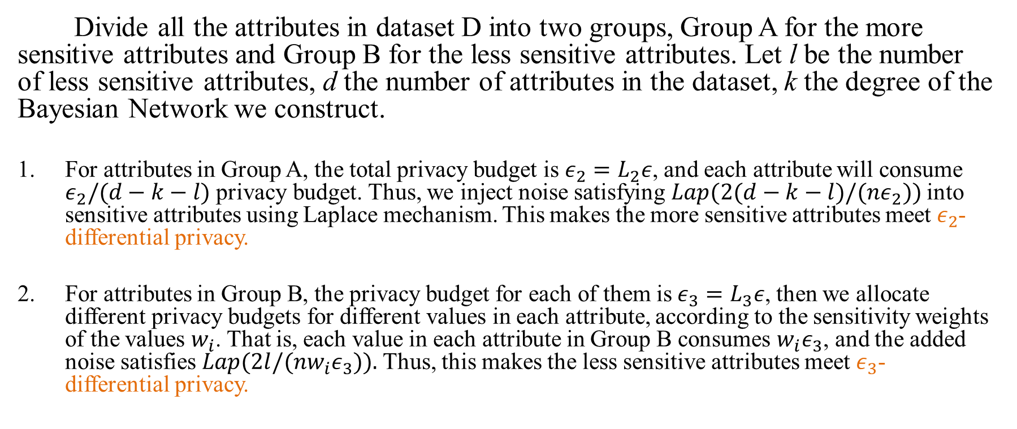
Personalized Privacy Allocation (see page 12-14)
Divide all the attributes in dataset D into two groups, Group A for the more sensitive attributes and Group B for the less sensitive attributes. Let l be the number of less sensitive attributes, d the number of attributes in the dataset, k the degree of the Bayesian Network we construct.
For attributes in Group A, the total privacy budget is $ε_{2}=L_{2}ε$, and each attribute will consume $ε_{2}/(d−k−l)$ privacy budget. Thus, we inject noise satisfying $Lap(2(d−k−l)/(nε_{2}))$into sensitive attributes using Laplace mechanism. This makes the more sensitive attributes meet$ε_{2}$-differential privacy.
For attributes in Group B, the privacy budget for each of them is$ε_{3}=L_{3}ε$, then we allocate different privacy budgets for different values in each attribute, according to the sensitivity weights of the values $w_{i}$. That is, each value in each attribute in Group B consumes $w_{i}ε_{3}$, and the added noise satisfies $Lap(2l/(nw_{i}ε_{3})).$Thus, this makes the less sensitive attributes meet $ε_{3}$- differential privacy.

Slide 13
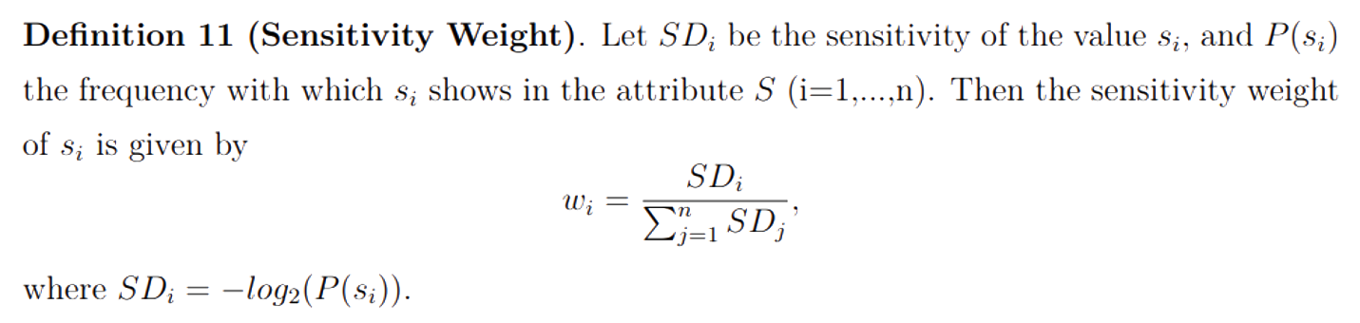
Sensitivity weight (see page 11)
Non-negative: All private data always has a certain sensitivity, once its sensitivity is 0, the data no longer belongs to the category of private data, and it does not need privacy protection.
Monotonous: The higher the sensitivity of a value, the greater the sensitivity weight of the value.
Negative correlation: The less frequently a sensitive value shows in the dataset, the more information it contains, thus, the greater sensitivity weight it has.

Slide 14
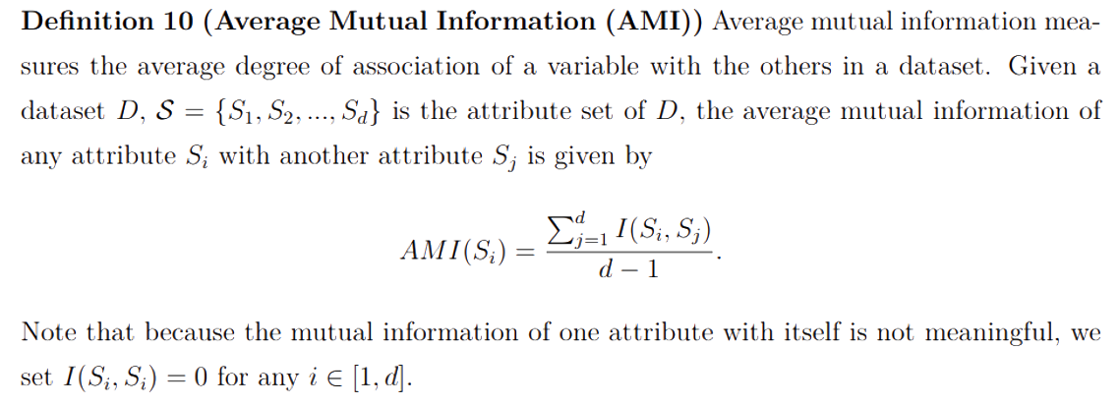
Improvement on Bayesian network construction (see page 10, 12)
Instead of using greedy algorithm, HPPrivBayes will use the average mutual information to determine the order in which the nodes enter the Bayesian network, increasing the amount of mutual information captured when selecting the AP pairs, which will in turn positively affect the quality of the network.

Slide 15
05
Experiments

Slide 16
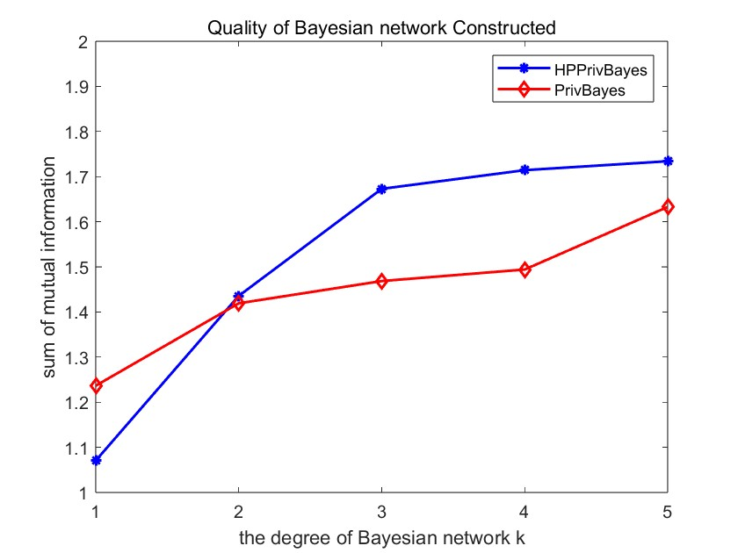
Bayesian network Quality Test (page 19)
The sum of mutual information of a Bayesian network can show its quality. According to the research of Zhang et al., it has been proved that the more the sum of mutual information caught by the Bayesian network, the higher the quality of the Bayesian network

Slide 17
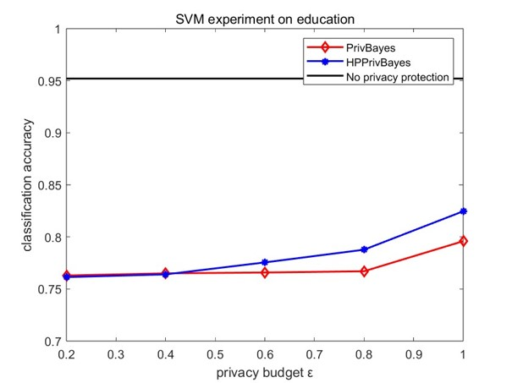
Algorithm Performance based on SVM (page 20)
SVM is a kind of binary classifier under supervised learning. In this test, we use SVM classifier on the new dataset generated by our algorithm to predict the value of attribute education and then compute the classification accuracy. SVM classification generally yields higher classification accuracies on better Bayesian network models.

Slide 18
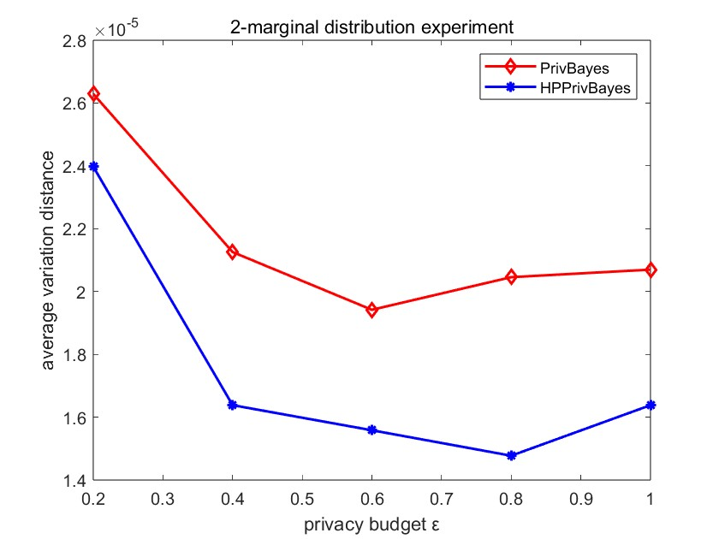
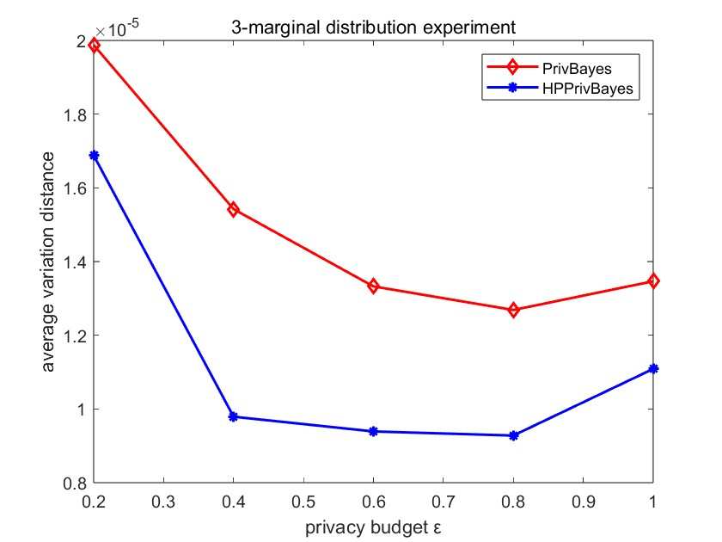
Algorithm Performance based on α-marginal distribution (page 21)
In this test, we calculate the average variation distance between the 2 and 3-marginal distribution of the original dataset D and the generated dataset D*.

Slide 19
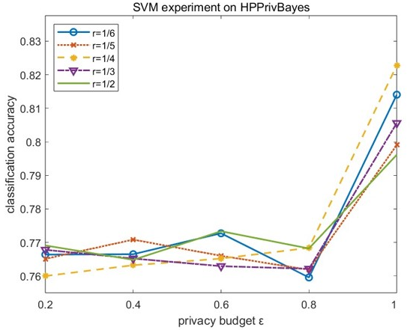
Test on r (page 22)
In this test, we want to investigate HPPrivBayes’ properties by adjusting the value of the budget allocation ratio parameter r of Group A to B. Note that r is the ratio of group A privacy budget allocated to group B privacy budget allocated.

Slide 20
06
Conclusions

Slide 21
Contributions:
Shortcomings:
The optimization of HPPrivBayes over PrivBayes for Bayesian network construction improves the quality of constructed networks successfully under most practical scenarios. And the personalized allocation of privacy budgets in HPPrivBayes not only satisfies the different requirements of different individuals and attributes but also maintains the usability of synthetic datasets at a relatively high level, especially when under loose privacy protection.
As we found that even though HPPrivBayes gets better results than PrivBayes in all experiments, it does not work very well for strong privacy protection, that is when ϵ is small. Perhaps further optimizations can be made to HPPrivBayes under a stronger privacy budget allocated situation. Besides, further improvements may also be made to avoid the algorithm being too sensitive to the parameter r.

Slide 22
Thank you!

